Slide 1


DATA SCIENCE PROJECT
PREDICTING THE PRICE OF BITCOIN BY BUILDING A MACHINE LEARNING MODEL

Slide 2

WHAT IS BITCOIN???
Bitcoin is a cryptocurrency[A cryptocurrency is a digital asset designed to work as a medium of exchange that uses strong cryptography to secure financial transactions], a form of electronic cash. It is a decentralized digital currency without a central bank or single administrator that can be sent from user-to-user on the peer-to-peer bitcoin network without the need for intermediaries.
Bitcoin was first released on 9th January,2009.
The present value of bitcoin is 6585$(4,89,826 rupees).

Slide 3
HOW BITCOIN TRANSACTIONS ARE DONE?
All transactions are done in BLOCKCHAIN. (A blockchain is a growing list of records, called blocks, which are linked using cryptography.).A transaction is a transfer of value between Bitcoin wallets that gets included in the block chain.Bitcoin wallets keep a secret piece of data called a private key or seed, which is used to sign transactions, providing a mathematical proof that they have come from the owner of the wallet. The SIGNATURE also prevents the transaction from being altered by anybody once it has been issued.

Slide 4
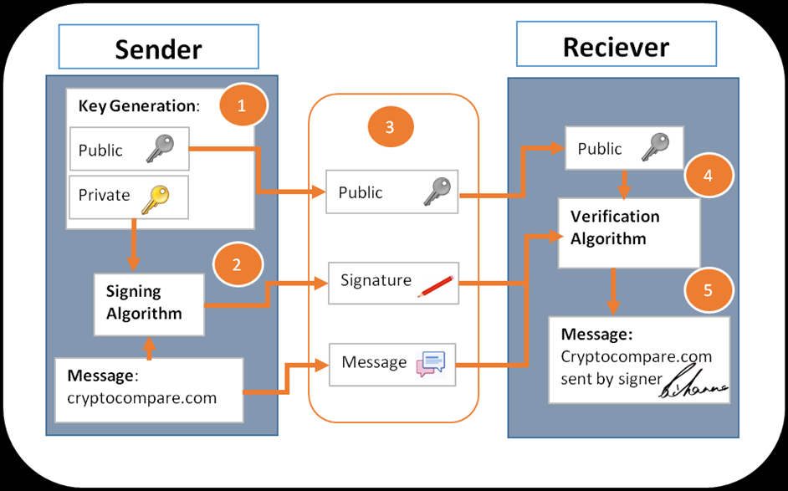
BITCOIN TRANSACTION

Slide 5
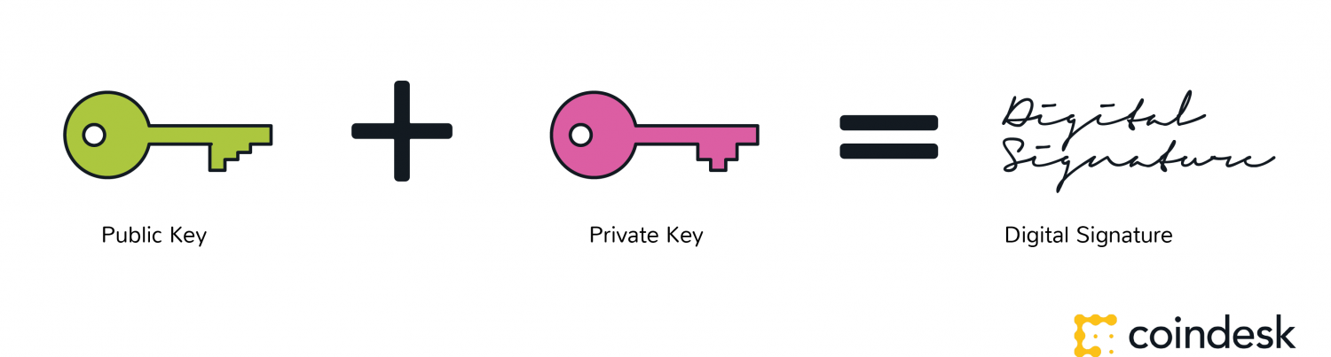
BITCOIN LEDGER
A ledger is the principal book or computer file for recording and totaling economic transactions.It is stored in the public blockchain (held on every computer running the Bitcoin client).This transaction volume would generate about 350 gigabytes on the blockchain every day, or 127 terabytes every year.

Slide 6
MACHINE LEARNING
WHAT IS MACHINE LEARNING?
Machine learning is an interdisciplinary field that uses statistical techniques to give computer systems the ability to "learn" from data, without being explicitly programmed.
EX: Google maps,Netflix,Uber all use machine learning techniques.
To predict the price of bitcoin we will be using “LINEAR REGRESSION”.

Slide 7
WHAT IS LINEAR REGRESSION?
First we need to know what is regression. Regression is a statistical measure used in finance, investing and other disciplines that attempts to determine the strength of the relationship between one dependent variable (usually denoted by Y) and a series of other changing variables (known as independent variables). Linear regressin is a statistical measure to fit a linear equation(Y=a+bX) into the data and by using least squares method the values of x and y can be found.

Slide 8
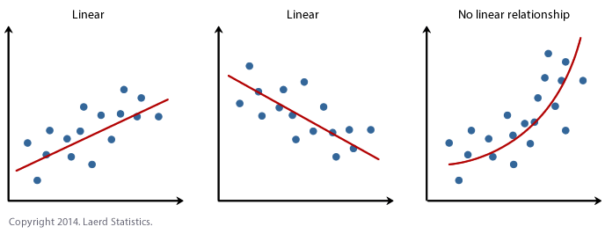
LINEAR RELATIONSHIP GRAPH

Slide 9
STEPS TO CREATE MACHINE LEARNING MODEL
IMPORTING THE SUITABLE DATASET
PLOTTING THE DATASET
PREPARING TRAIN SET
APPLYING LINEAR REGRESSION
CALCULATING PREDICTED VALUES
PLOTTING PREDICTED VALUES ALONG ORIGINAL VALUES.

Slide 10
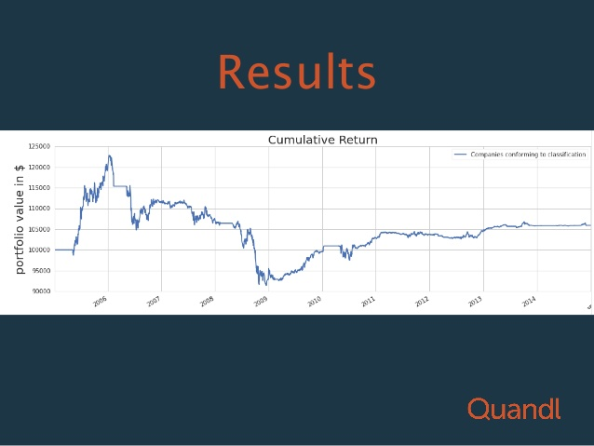
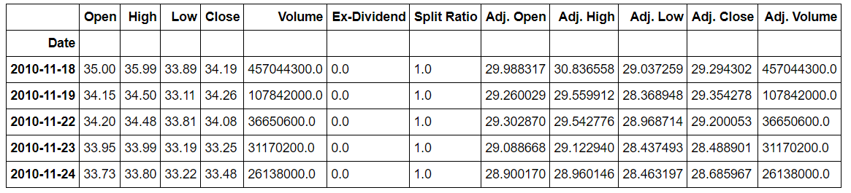
IMPORTING DATASET-QUANDL
Quandl is a platform for economic data that manages to track various stocks and cryptocurrencies and provides datasets for financial professionals.Special thing is it is also present as a module in PYTHON programming.

Slide 11
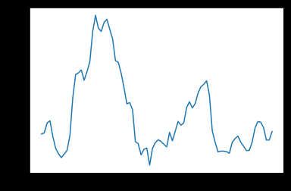
PLOTTING DATASETS
Many modules such as numpy,pandas,datetime and aslo quandl to import dataset and plot them.Numpy is the module imported and used to plot the datasets in the form of a graph.
Training sets are prepared in order to evaluate and check the accuracy of the datset model.

Slide 12
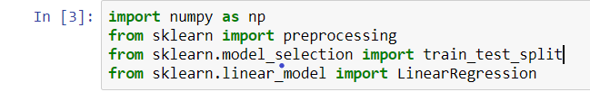
PERFORMING LINEAR REGRESSION
Scikit-learn is a python module available which contains various regression,classification algorithms including support vector machines.From this module we can import linear regression and training set algorithms.
Using this we directly import linear regression algorithm and write the following functions.

Slide 13
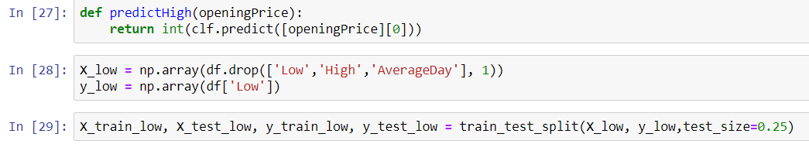
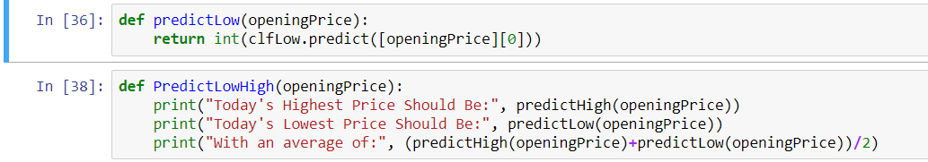
WRITING REGRESSION FUNCTIONS
We write two functions predictHigh() and predictlow()

Slide 14
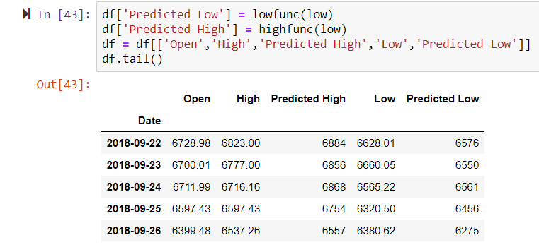
PLOTTING AND COMPARING
After getting the predicted values we plot the original values ase well as the duplicate values uding numpy and pandas modules..

Slide 15
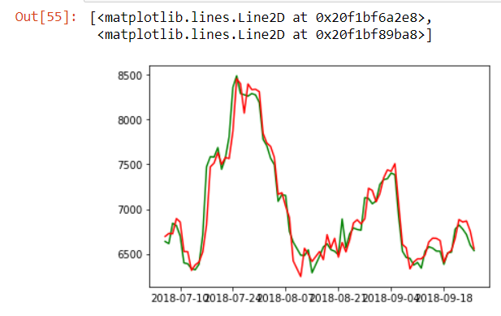
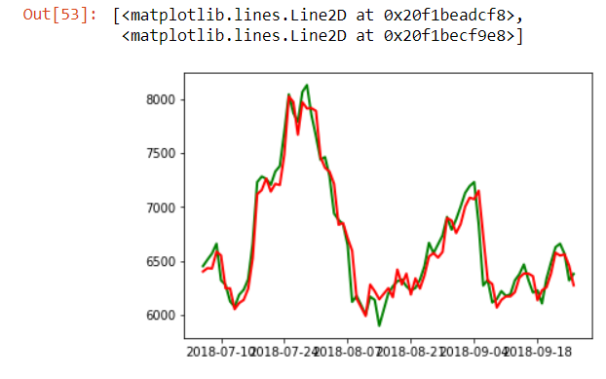
FINAL GRAPHS
ORIGINAL VALUES-green PREDICTED VALUES-red
PREDICTED HIGH PREDICTED LOW

Slide 16
THANK YOU

